Slide 1
Presentation
Șotropa Diana, PHD, Lecturer

Slide 2
Faculty of Mathematics and Computer Science Babeș-Bolyai University
Motto: Your Career, Our Duty

Slide 3
About us
Being an important component of a prestigious University, the Faculty of Mathematics and Computer Science is now a perfect blending of tradition and present, modernity and experience.
The classification of the Mathematics field in Best Global Universities and The world’s best universities for Mathematics rankings is a recognition of the value of the School of Mathematics from Romania and in particular from Babes-Bolyai University in Cluj-Napoca, a value based on tradition, work and seriousness in a climate of honest competition.

Slide 4
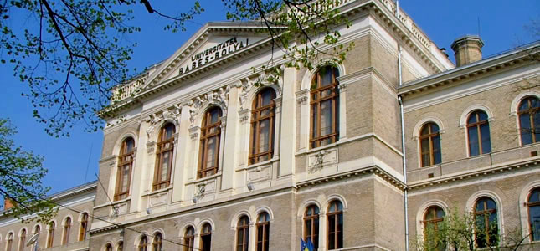


About us
Cluj-Napoca has become an important centre for Information Technology and Communications on the map of Europe due to the good training of the Computer Science graduates from our faculty.
Graduates of Computer Science at Babes-Bolyai University are highly valued by companies in the field, with a real "talent hunting" going on even since their student years.

Slide 5
Departaments
Faculty of Mathematics and Computer Science

Slide 6
Departaments
Department of Mathematics
Department of Computer Science
Department of Mathematics and Computer Science in Hungarian

Slide 7
Specialisations
Faculty of Mathematics and Computer Science

Slide 8
Bachelor’s academic programmes
Mathematics
Computer science
Mathematics Romanian
Mathematics Hungarian
Mathematics Computer Science Romanian
Mathematics Computer Science Hungarian
Mathematics Computer Science English
Computer Science Romanian
Computer Science English
Computer Science Hungarian
Computer Science German

Slide 9
Master’s academic programmes
Computer science
Mathematics
Education Sciences
Data Analysis and Modelling Hungarian
Databases Romanian
High Performance Computing and Big Data Analytics English
Modern Methods in Teaching Computer Science Romanian
Modern Methods in Teaching Computer Science Hungarian
Software Engineering English
Applied Computational Intelligence English
Component-Based Programming English
Enterprise Software Design and Development Hungarian
Distributed Systems in Internet Romanian
Advanced Computer Science Systems: Modeling, Design and Development German, English
Computational Mathematics Hungarian
Modern Methods in Teaching Mathematics Romanian
Modern Methods in Teaching Mathematics Hungarian
Advanced Mathematics English
Master in Didactics - Computer Science Romanian
Master in Didactics - Mathematics Hungarian
Master in Didactics - Computer Science Hungarian

Slide 10
Research Centers
Faculty of Mathematics and Computer Science

Slide 11
Accredited Research Centers by the Babeş-Bolyai University
Research Center of Applied Analysis, Supervisor: Dr. Radu Precup, Professor
Research Center of Algebras, Groups and Application, Supervisor: Dr. Andrei Mărcuş, Professor
Applied Computational Intelligence Research Center, Supervisor: Dr. Horia F. Pop, Professor
Software Engineering Research Center, Supervisor: Dr. Simona Motogna, Associate Professor
Centre for the Study of Complexity, Supervisor: Dr. Rodica Lung, Associate Professor

Slide 12
Research groups on Mathematics accredited by the faculty
Analysis and Optimization Research Group, Supervisors: Dr. Kassay Gábor, Professor and Dr. Nicolae Popovici, Professor
Geometry Research Group, Supervisor: Dr. Dorin Andrica, Professor
Complex Analysis Research Group, Supervisor: Dr. Gabriela Kohr, Professor
Nonlinear Operators and Differential Equations Research Group, Supervisors: Dr. Radu Precup, Professor and Dr. Adrian Petruşel, Professor
Numerical and Stochastic Analysis Research Group, Supervisor: Dr. Octavian Agratini, Professor
Mechanics and Astronomy Research Group, Supervisor: Dr. Mirela Kohr, Professor
Simulation Modelling Control and Visualization Research Group, Supervisor: Dr. Libál András, Associate Professor

Slide 13
Research groups on Computer Science accredited by the faculty
Research group on Machine Learning, Supervisor: Dr. Gabriela Czibula, Professor
Distributed Systems and Web Communication Research Group, Supervisor: Dr. Rareş Boian, Associate Professor
High Performance Interdisciplinary Applications Research Group, Supervisor: Dr. Virginia Niculescu, Associate Professor
Formal Concept Analysis Research Group, Supervisor: Dr. Christian Săcărea, Associate Professor
Metaheuristics for Complex Systems Research Group, Supervisors: Dr. Anca Andreica, Professor and Dr. Laura Dioșan, Professor

